Slide 1
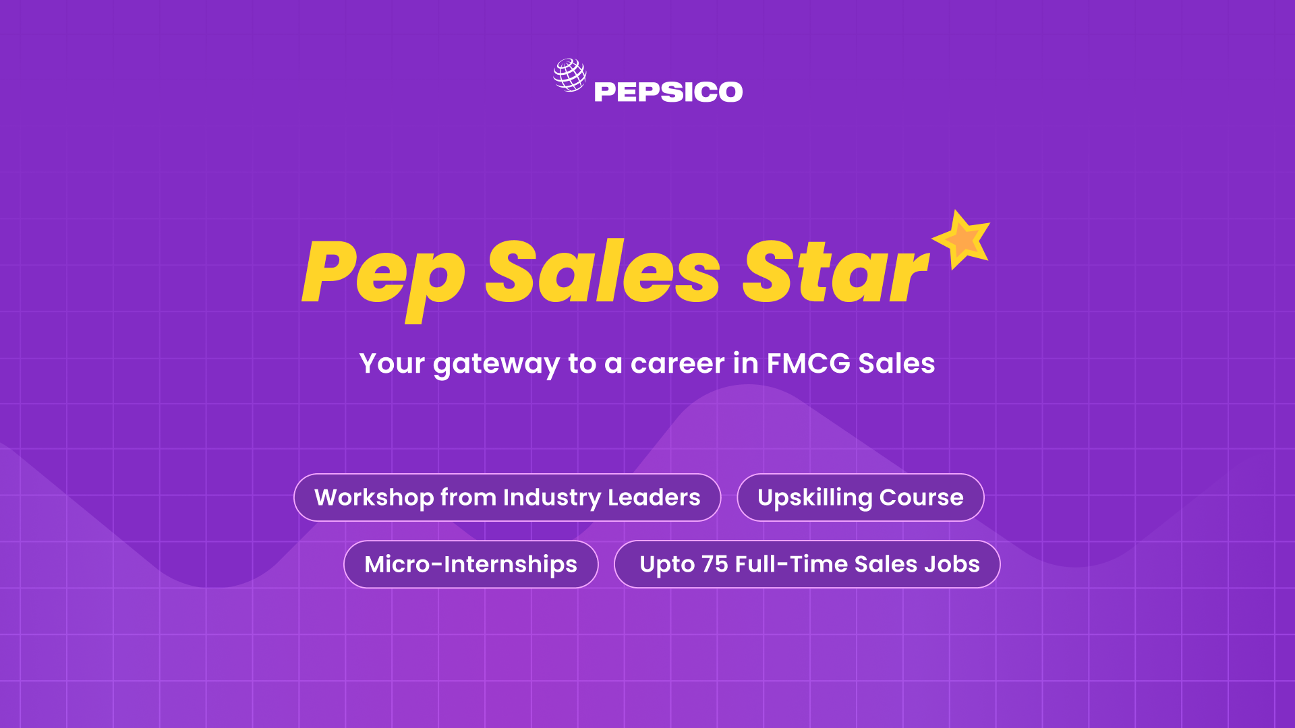

Final Submission
Notes:
‹#›

Slide 2

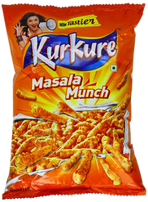
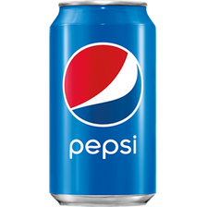
Introduction
Name:
Dendi Priyanka Reddy
College:
Maturi Venkata Subba Rao Engineering College, Nadergul
City:
Hyderabad
Email Id:
245122735003@mvsrec.edu.in
How many shops/ retail outlets did you visit in total?
25

Slide 3
List the names of the 25 outlets you visited
Madhuraj Dairy and Daily Needs
Jyoti Super Bazaar
Krushna Provisions
Lucky Daily Needs
Mother Dairy Maa Jaisi
Rani Daily Needs
Kunal Super Bazzar
Chi Grocery Store
Sai Daily Needs
Mother Dairy Maa Jaisi 2
Reliance Smart Superstore
Dolly Sweet and Namkeen

Slide 4
List the names of the 25 outlets you visited
13.Maa Vaisho-devi Tee House
14.Jain Provisions
15.Aaryn Daily Needs
16.Tridevi Daily Needs
17.Rajju Point
18.Mamta Super Mart
19.Shri Daily Needs
20.Shri Ambika Store
21.Gajanan Daily Needs
22.Priya Store
23.Lakhan Store
24.Aaditya Ice-cream Store
25.Ujwal Provisions

Slide 5
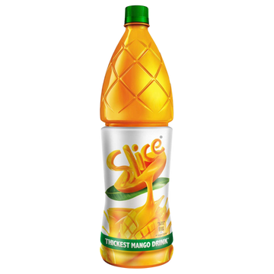

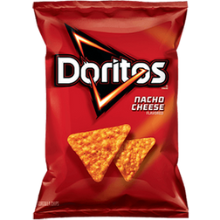
Observations and Insights
Answer the following questions based on your market research
How many competition brands did you see in the market? (give names of all the brands)
Ans. Based on my store visits, I identified 3 unique competition brands that have a noticeable rack presence in the market.
These brands are:
Coca-Cola Company (which includes products like Maaza and other beverages)
Mondelez (Cadbury) (which includes products like Dairy Milk)
Haldiram
Detailed Competitor Rack Presence:
Compeitor | Number of Stores with Rack Presence
Coca-Cola Company | 15
Mondelez (Cadbury) | 14
Haldiram | 14

Slide 6
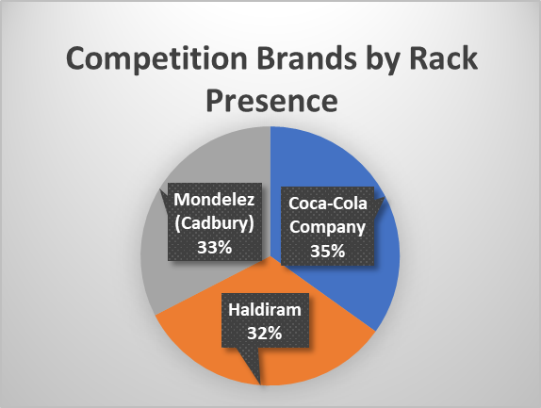
Observations and Insights
Answer the following questions based on your market research
How many competition brands did you see in the market? (give names of all the brands)
Ans. Analysis from the Pie Chart and Table:
The pie chart, paired with the table, paints a clear picture of our top competitors' presence on store racks. Coca-Cola leads the pack, seen in 15 stores. Hot on their heels are Mondelez (Cadbury) and Haldiram, each found in 14 stores. This combined view quickly shows us both the exact numbers and the overall competitive landscape.

Slide 7
Observations and Insights
Answer the following questions based on your market research
What was the most visible brands in the western salty snacks category? (answer with analysis from the total stores you visited)
Ans. To pinpoint the most visible salty snack brands, we looked at rack presence. My data shows PepsiCo's salty snacks (like Lay's and Doritos) are highly visible, with their racks found in 13 out of 25 stores. Right alongside them is Haldiram, which was noted in 14 stores, indicating a strong competitive presence. Essentially, both PepsiCo's own snack lines and Haldiram are the most visible in this category across the stores I visited.
Brand Category:
Brand Category | Count
Haldiram | 14
PepsiCo Salty Snacks (Implied) | 13

Slide 8
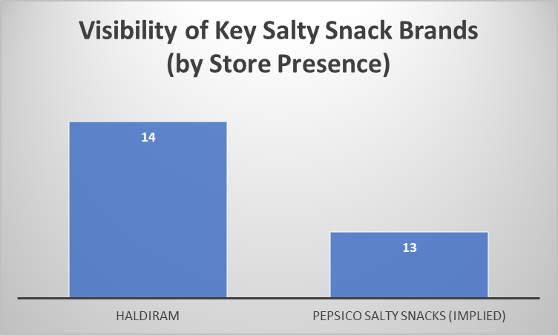
Observations and Insights
Answer the following questions based on your market research
What was the most visible brands in the western salty snacks category? (answer with analysis from the total stores you visited)
Ans. Analysis from Bar chart and table
This chart visually compares the presence of top salty snack brands across stores. Each bar's length shows the number of stores where that brand's rack was seen. You'll notice Haldiram's bar is slightly longer, indicating a marginally higher presence than PepsiCo's salty snacks. Data labels on each bar provide exact store counts for quick reference.

Slide 9
Observations and Insights
Answer the following questions based on your market research
Out of the store you visited, how many stores had a rack? Give the total number of store you visited also.
Ans.
Total Stores Visited: Visited a total of 25 stores.
Stores with a PepsiCo Rack: Out of these 25 stores, 13 stores had a PepsiCo rack present.
This means that while just over half of the stores had a PepsiCo rack, there's a significant opportunity for expansion in the remaining stores.
PepsiCo Rack Presence Across Stores:
Category | Count
Stores with PepsiCo Rack | 13
Stores without PepsiCo Rack | 12
Stores Visited | 25

Slide 10
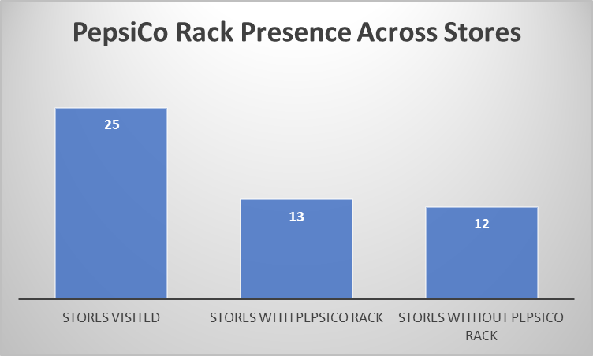
Observations and Insights
Answer the following questions based on your market research
Out of the store you visited, how many stores had a rack? Give the total number of store you visited also.
Ans. Analysis from Column chart and table
This column chart visually summarizes PepsiCo's rack presence. The height of each column shows the number of stores: 13 stores had a PepsiCo rack, while 12 did not. This highlights that roughly half of the surveyed stores are currently unequipped with a dedicated PepsiCo display, indicating potential for growth.

Slide 11
Observations and Insights
Answer the following questions based on your market research
What is your one recommendation to PepsiCo to increase further presence in the outlets where we were not present?
Ans.
My Key Recommendation:
PepsiCo should conduct a targeted follow-up at the 12 stores without racks to identify precise display space.
Why This Recommendation?
My data for 11 of these stores lacked space details. Knowing exact availability is crucial for strategic rack placement and efficient market expansion.

Slide 12
THANK YOU !

